Slide 1
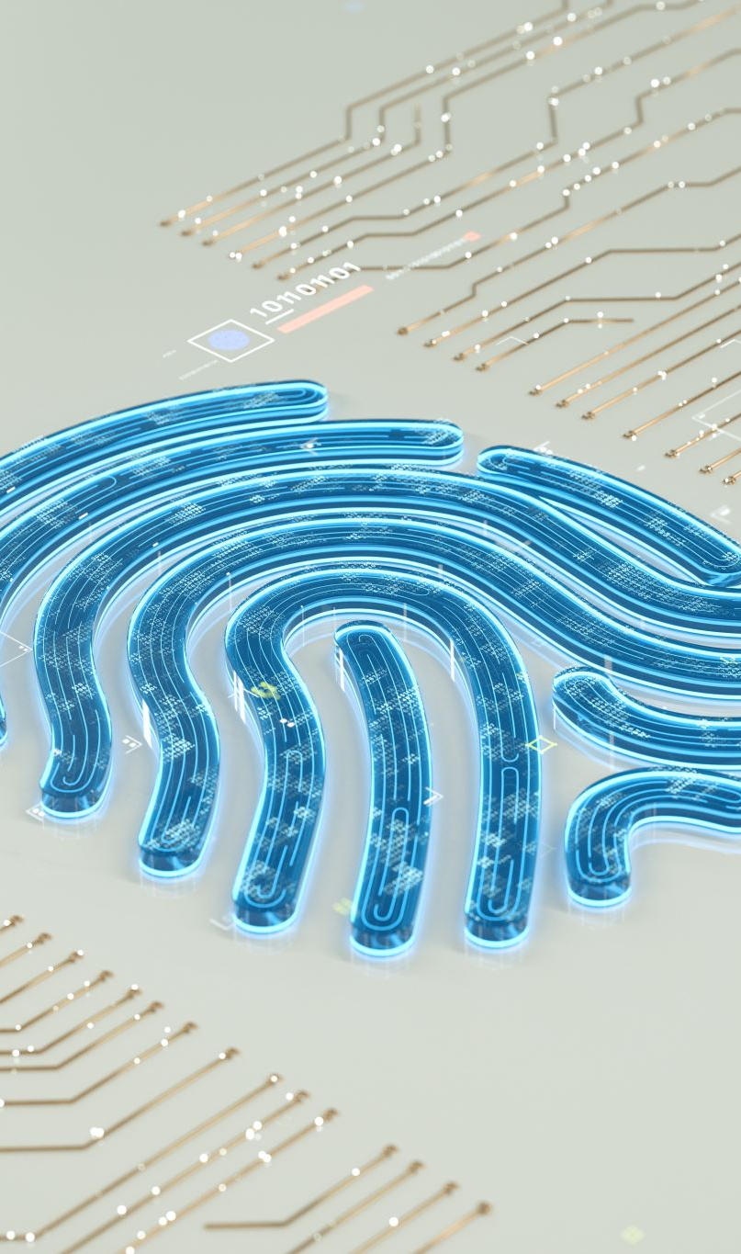
Governance, Risk and Compliance

Slide 2
Domain 1
Session 1 Information Security Risk Management Program
Session 2 Prepare Stage of RMF
Session 3 Categorize information System
Session 4 Selection of Approval of Security Privacy Controls
Session 5 Implementation of Security Privacy Controls
Session 6 Assessment / Audit of Security Controls
Session 7 Authorization / Approval of information System
Session 8 Continuous Monitoring
Session 9 Vulnerability Management
Session 10 Analyzing Scan Results

Slide 3
Session 1: Information Security Processes & Concepts
To successfully deploy risk-based IT systems, you must understand the following security concepts and processes:
Basic Terms – Threat, Vulnerability & Risk
System Risk | Potential Impact | Security Control
System Development Life Cycle [ SDLC ]
Risk Management
Relevant Standards & Regulations

Slide 4
Infosec Processes & Concepts – Basic Terms
• Asset – People, Systems, Property and information
• An asset is what you are trying to protect
• Threat – Anything that can exploit a vulnerability, intentionally or accidentally, and obtain, damage, or destroy an asset.
• A threat is what we are trying to protect against
• Examples of threats are Phishing, Malware
• Vulnerability – Weaknesses or gaps in a security program that can be exploited by threats to gain unauthorized access to an asset.
• A vulnerability is a weakness or gap in our protection efforts.
• Likelihood - The probability that a potential vulnerability may be exploited within the construct of the associated threat environment.
• Determined by analyzing the threats to an information system in
conjunction with the potential vulnerabilities and the controls in place .

Slide 5
Infosec Processes & Concepts – Basic Terms
• INFORMATION SECURITY : The protection of information and informationsystems from unauthorized access, use, disclosure, disruption, modification, or destruction in order to provide confidentiality, integrity, and availability .
The goal of an information security program is to understand and manage risk
to information under the control of the organization.
• INFORMATION SYSTEM: A discrete set of information resources organized for the collection, processing, maintenance, use, sharing, dissemination, or disposition of information.
• RISK: The level of impact on organizational operations (including mission, functions, image, or reputation), organizational assets, or individuals resulting from the operation of an information system given the potential impact of a threat and the likelihood of that threat occurring.
Risk can also be defined as the potential for loss, damage or destruction of an asset as a result of a threat exploiting a vulnerability.

Slide 6
Infosec Processes & Concepts – Basic Terms
• Security Objectives: Information security is accomplished through a set of
security controls deployed across the organization’s computing environment with
the goal of protecting three information security objectives: Confidentiality,
Integrity & Availability
• Confidentiality: Seeks to prevents the disclosure of information to unauthorized
individuals or systems.
• Loss of confidentiality is the unauthorized disclosure of information.
• Integrity: Seeks to prevents the unauthorized modification or destruction of
information.
• Loss of integrity is the unauthorized modification of information.
• Availability: Ensures timely and reliable access to and use of information.
• Loss of availability is the disruption of access to or use of information or an
information system.

Slide 7
Infosec Processes & Concepts – System Risk
• Risk:
A measure of the extent to which an entity is threatened by a potential circumstance or event and is typically a function of the likelihood of the circumstance or event occurring and of the resulting adverse impacts .
Risk = Likelihood x Impact
• Adequate Security:
Security commensurate with risk includes both the Likelihood and Magnitude of harm resulting from the loss, misuse, or unauthorized access or modification of information.

Slide 8
Infosec Processes & Concepts – Security Objectives
• Potential Impact: 3 levels of impact should there be a breach of security (a loss of C.I.A)
• Low : event has a limited adverse effect on organizational operations, assets, or individuals.
• Minor harm
• Moderate: event has a serious adverse effect on organizational operations, assets, or individuals. Significant.
• No loss of life or serious life-threatening injuries
• High: High event has a severe or catastrophic adverse effect on organizational
operations, assets, or individuals.
• Loss of life or serious life-threatening injuries

Slide 9
Infosec Processes & Concepts – Security Objectives
• Security Controls: Safeguards or countermeasures to avoid, counteract or minimize security risks.
• Classification of Controls : By time of occurrence, relative to a security incident:
1. Preventive controls: are intended to prevent an incident from occurring e.g., by locking out unauthorized intruders, Firewall.
2. Detective controls: are intended to identify and characterize an incident in progress e.g., by sounding an alarm and alerting the security guards or police, IDS.
3. Corrective controls: are intended to limit the extent of any damage caused by the incident e.g., by recovering the organization to normal working status as efficiently as possible. Back ups.
4. Deterrent controls: are controls that discourage security violations. For instance, the presence of security cameras might deter an employee from stealing equipment.
5. Compensating controls: are intended to reduce the risk of an existing or potential control weakness; or in place of a missing control.

Slide 10
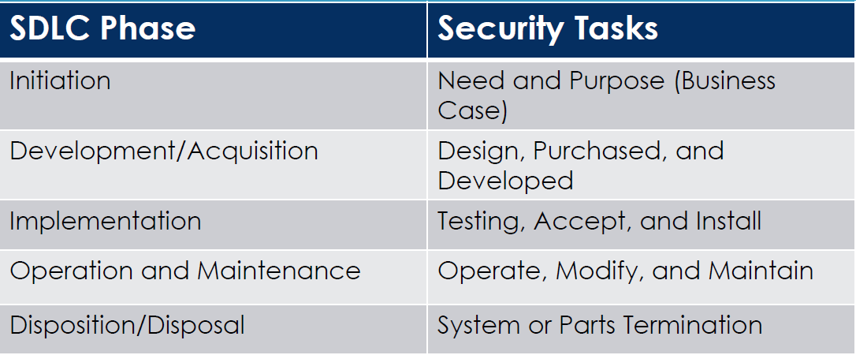
Infosec Processes & Concepts – SDLC
• System Development Life Cycle: SDLC is a conceptual model used in project management that
describes the stages involved in an information system development, from initial feasibility study through maintenance of the complete application.
A typical SDLC includes 5 phases with a minimum set of security tasks needed to effectively incorporate security in the system development process.

Slide 11
Infosec Processes & Concepts – RMF
• RISK MANAGEMENT FRAMEWORK
Office of Management & Budget (OMB) Was tasked to conduct annual review of agencies information security program to ensure it complies with FISMA Act 2002.
Dept of Commerce/National Institute of Standards & Technology (NIST) NIST is responsible for developing information security standards and guidelines, including minimum requirements for federal information systems. (OMB) Circular A 130, Section 8b(3).

Slide 12
Infosec Processes & Concepts – RMF
• RISK MANAGEMENT FRAMEWORK (RMF) NIST 800-37 RV 1/2
Starting Point
SP 800-37 RV2
PREPARE
FIPS 199 / SP 800-60
CATEGORIZE Information System
FIPS 200 / SP 800-53
SELECT
Security Controls
SPs / 800-70
IMPLEMENT
Security Controls
SP 800-53A
ASSESS
Security Controls
SP 800-37
AUTHORIZE
Information System
SP 800-137
MONITOR
Security State

Slide 13
Infosec Processes & Concepts – RMF
• RISK MANAGEMENT FRAMEWORK (RMF) NIST 800-37 RV ½
NIST RMF Steps
Step 1 - Prepare
• Prepare the organization to manage its security and privacy risks using the Risk Management Framework.
Step 2 - Categorize Information System
• Categorize the system, identify security objectives, and determine the highwater Mark.
Step 3 - Select Security Controls
• Select a baseline of security controls based on the Security Categorization
• Tailor and supplement the control baseline based on a risk assessment
Step 4 - Implement Security Controls
• Implement and describe how the controls are used within the system

Slide 14
Infosec Processes & Concepts – RMF
• RISK MANAGEMENT FRAMEWORK (RMF) NIST 800-37 RV ½
NIST RMF Steps
Step 5 –Assess Security Controls
• Assess the controls to determine the extent to which they are implemented correctly, operating as intended and producing the desired outcome
Step 6 - Authorize Information System
• Authorize the system based on the determination of acceptable risk to the organization
Step 7 - Monitor Security Controls
• Continuously monitor system controls assessing effectiveness, documenting changes, and reporting the security posture to officials

Slide 15
Classwork 1
Give a brief description on the following NIST Special Publications;
NIST SP 800 137
NIST SP 800 60 VI rev 1
NIST SP 800 53 rev4 / r5
NIST SP 800 53A rev4 / rv5
NIST SP 800 37rev1 or rev 2

Slide 16
Class Discussion
Discussion of NIST publications
What are CIA Triad
How is Risk calculated
Walk me through the RMF Framework
What is the fourth stage of SDLC phase?
How often do we conduct ATO?
How often do we conduct assessments?

Slide 17
Homework 1
1. Give a brief description on the following NIST Special Publications.
NIST SP 800 30 rev1
NIST SP 800 39
NIST SP 800 115
NIST SP 800 18rev1
FIPS 199
FIPS 200
Walk me through the RMF Steps.
info@delojik.com

Slide 18
Session 2: Prepare Stage of RMF
Starting Point
SP 800-37 RV2
PREPARE
FIPS 199 / SP 800-60
CATEGORIZE Information System
FIPS 200 / SP 800-53
SELECT
Security Controls
SPs / 800-70
IMPLEMENT
Security Controls
SP 800-53A
ASSESS
Security Controls
SP 800-37
AUTHORIZE
Information System
SP 800-137
MONITOR
Security State

Slide 19
RISK MANAGEMENT FRAMEWORK (PREPARE)
OBJECTIVE
The objective of the Prepare step is to carry out essential activities at the organization, mission and business process, and information system levels of the organization to help prepare the organization to manage its security and privacy risks using the Risk Management Framework.

Slide 20
Prepare Stage of RMF
RISK MANAGEMENT ROLES
Identify individuals and assign key roles for executing the Risk Management Framework
Head of Agency; Chief Information Officer; Senior Agency Official for Privacy.
Authorizing Official or Authorizing Official Designated Representative
Information Owner or Steward;
Senior Agency Information Security Officer;
Senior Agency Official for Privacy;
Chief Acquisition Officer.
References
• FIPS 199
• NIST SP 800-37 RV2 , 800-30, 800-39

Slide 21
Session 3: Categorize Information System
Starting Point
SP 800-37 RV2
PREPARE
FIPS 199 / SP 800-60
CATEGORIZE Information System
FIPS 200 / SP 800-53
SELECT
Security Controls
SPs / 800-70
IMPLEMENT
Security Controls
SP 800-53A
ASSESS
Security Controls
SP 800-37
AUTHORIZE
Information System
SP 800-137
MONITOR
Security State

Slide 22
Definitions
Sensitivity
A measure of the importance assigned to information by its owner for the purpose of denoting its need for protection
Criticality
A measure of the degree to which an organization depends on the information or information system for the success of a mission or of a business function

Slide 23
Potential Impact
Determine the potential impact for each Security objective associated with the information type:
Security Category
SC infotype = {(confidentiality , impact), (integrity , impact), (availability , impact)}

Slide 24
Potential Impact Example
An organization managing public information on its web server determines that there is no
potential impact from a loss of confidentiality , a moderate potential impact from a loss of
integrity , and a moderate potential impact from a loss of availability.
The resulting security category, SC , of this information type is expressed as
Sc-public information = {(confidentiality , L)),( integrity , M ), (availability , M)}
High Water Mark
Overall Information System Impact: MODERATE

Slide 25
System Security Plan (SSP)
The system security plan describes the system components that are included within the system, the environment in which the system operates, how the security requirements are implemented, and the relationships with or connections to other systems. System Owner is responsible for the plan , but it can be delegated to the ISSO
Plan Initiation: Initiated during the RMF Step 2 and updated throughout the systems life cycle and subsequent RMF steps.
Plan Maintenance: The Security Plan is a living document and should be kept up to date. It should be reviewed annually at a minimum and should be aligned with organizational policy revisions and change management processes.
Plan Security: Since the SSP documents the security specification of the system , the plan should be safeguarded and given the appropriate classification.
System Type: General Support system, Major application and Minor application

Slide 26
System Security Plan Components
1. General Information – System Description
2. Boundary – Hardware and Software Inventory
3. Security Category – System security category, Privacy Threshold Analysis, Privacy Impact Assessment
4. Risk Assessment – Conduct all steps of risk assessment (Prepare, Conduct, Communicate, Maintain)
5. Controls – Allocated controls i.e Rev 5 controls (394)
6. SAP/SAR – Security Assessment Plan, Security Assessment Report
7. POA&M / RBD – Plan of actions and Milestone, Risk Based Decision
8. Diagrams/CP- Boundary Diagram, Network Architecture, Contingency Plan
9. Authorization – Authorization conditions, renewed every 3 years
10. Monitor – Continuous Monitoring
11. Supporting Documents
12. Decommission

Slide 27
System Security Plan Summary
Security categorization requires an in-depth analysis of the organization s mission and business processes to identify the types of information that will be processed , stored , or transmitted by the information systems.
Security categorization also provides the information needed for the succeeding steps in the Risk
Management Framework

Slide 28
Class Discussion
What type of system have you worked on?
SAP or SAR which comes first during assessment and authorization?
What is the difference between POA&M and RBD?
How often is system categorization done?
What is contingency plan?
What are risk assessment steps?

Slide 29
Classwork 2
System Categorization Exercise
Use NIST Publication to Categorize information type

Slide 30
Class Discussion
1. An information system used for large acquisitions in a contracting organization contains both sensitive, pre solicitation phase contract information, and routine administrative information The management within the contracting organization determines that:
a. For the sensitive contract information the potential impact from a loss of confidentiality is moderate the potential impact from a loss of integrity is moderate and the potential impact from a loss
of availability is low and
b. For the routine administrative information non privacy related information the potential impact from a loss of confidentiality is High the potential impact from a loss of integrity is low and the potential impact from a loss of availability is Moderate.
Calculate the overall High Water Mark

Slide 31
Homework
Complete the Security Categorization worksheet based on Adjusted Impact level by the system owner as indicated on the security categorization worksheet. Refer to NIST 800-60 Page 25.
Submit to info@delojik.com by 30th May 2024.

Slide 32
Session 4: Selection of Security Privacy Controls
Starting Point
SP 800-37 RV2
PREPARE
FIPS 199 / SP 800-60
CATEGORIZE Information System
FIPS 200 / SP 800-53
SELECT
Security Controls
SPs / 800-70
IMPLEMENT
Security Controls
SP 800-53A
ASSESS
Security Controls
SP 800-37
AUTHORIZE
Information System
SP 800-137
MONITOR
Security State

Slide 33
Selection of Security Privacy Controls
Objective
Understand how to select security controls meeting the security baseline commensurate with the system’s high water.
The purpose of the Select step is to select, tailor, and document the controls necessary to protect the information system and organization commensurate with risk to organizational operations and assets, individuals, other organizations, and the Nation.

Slide 34
Selection of Security Privacy Controls

Slide 35
Selecting Security Controls
This step requires selecting an initial set of security controls from the SP 800-53 rev 5 Security Control Catalog for the information system based on
The Security Categories for each data type on the system
The overall Potential Impact Level of the system
Applying tailored guidance based on risk to acquire a starting point in determining the required controls

Slide 36
Classes of Security Controls

Slide 37
Security Control Families
The minimum security requirements covering 20 selected security control families
Assist in protecting the confidentiality, integrity, and availability of federal information systems and the information processed, stored, and transmitted by those systems
Families are assigned to their respective classes based on the main characteristics of the controls.

Slide 38
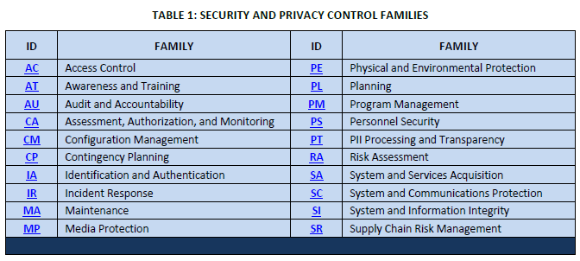
Security Control Families

Slide 39
Security Control Families
Access Control (AC): Organizations must limit information system access to authorized users, processes acting on behalf of authorized users, or devices (including other information systems) and to the types of transactions and functions that authorized users are permitted to exercise.
Awareness and Training (AT): Organizations must:
(i) ensure that managers and users of organizational information systems are made aware of the security risks associated with their activities.
(ii) ensure that organizational personnel are adequately trained to carry out their assigned information security-related duties and responsibilities.
Audit and Accountability (AU): Organizations must:
(i) create, protect, and retain information system audit records to the extent needed to enable the monitoring, analysis, investigation, and reporting of unlawful, unauthorized, or inappropriate information system activity; and
(ii) ensure that the actions of individual information system users can be uniquely traced to those users so they can be held accountable for their actions.

Slide 40
Security Control Families
Physical and Environmental Protection (PE): Organizations must:
(i) limit physical access to information systems, equipment, and the respective operating environments to authorized individuals;
(ii) protect the physical plant and support infrastructure for information systems and provide appropriate environmental controls in facilities containing information systems.
Planning (PL): Organizations must develop, document, periodically update, and implement security plans for organizational information systems that describe the security controls in place and the rules of behavior for individuals accessing the information systems.
Risk Assessment (RA): Organizations must periodically assess the risk to organizational operations, assets, and individuals, resulting from the operation of organizational information systems, processing, or storage.

Slide 41
Security Control Families – NIST Publications
FIPS 200
Describes the minimum security requirements for information and information systems
Defines twenty security-related areas which comprise the security control families
Sets the process for using the information system's high-water mark to identify the tailored set of baseline security controls to implement
• SC (system) = Low Impact use Low Baseline
• SC (system) = Moderate Impact use Moderate Baseline
• SC (system) =High Impact use High Baseline

Slide 42
Security Control Families – NIST Publications
NIST SP 800-53 rev 5
The security control structure consists of the following components
• a control section
• a supplemental guidance section
• a control enhancements section
• a references section
• a priority and baseline allocation section

Slide 43
Security Control Families – Summary

Slide 44
Class Discussion
How many control families do we have?
What are the classes of control?
List at least 5 control families

Slide 45
Classwork 3
Work on SSP Template using NIST 800-53 rv 4 and r5

Slide 46
Homework 3
Complete SSP worksheet control requirements

Slide 47
Session 5: Implementation of Security Privacy Controls
Starting Point
SP 800-37 RV2
PREPARE
FIPS 199 / SP 800-60
CATEGORIZE Information System
FIPS 200 / SP 800-53
SELECT
Security Controls
SPs / 800-70
IMPLEMENT
Security Controls
SP 800-53A
ASSESS
Security Controls
SP 800-37
AUTHORIZE
Information System
SP 800-137
MONITOR
Security State

Slide 48
Implementation of Security Privacy Controls
Objective
Understand how to implement security control as described in the System Security plan.
The purpose of the Implement step is to implement the controls in the security and privacy plans for the system and for the organization and to document in a baseline configuration, the specific details of the control implementation.
1. The control is selected correctly,
2. operating as intended and
3. producing desired result.

Slide 49
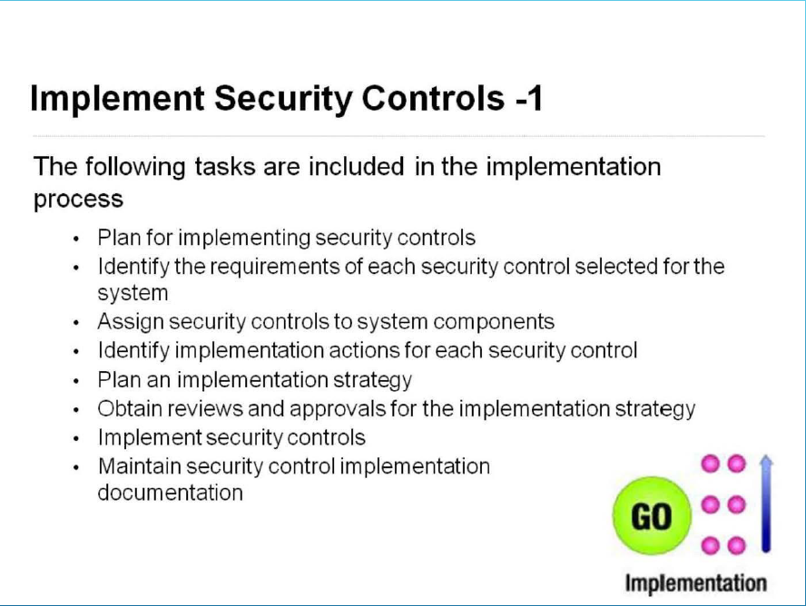
Implementation of Security Privacy Controls

Slide 50
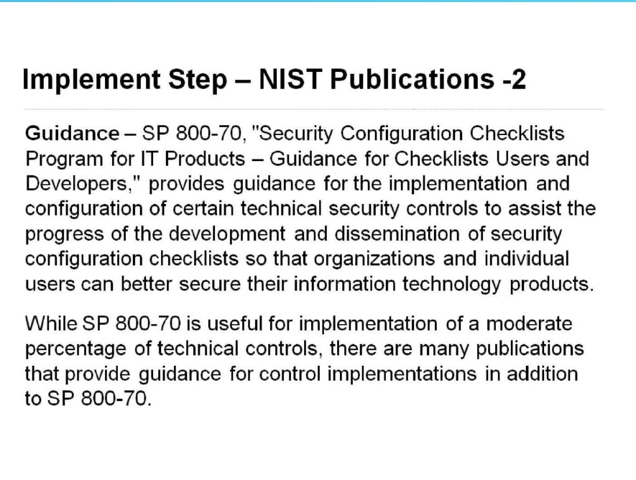
Implementation of Security Privacy Controls

Slide 51
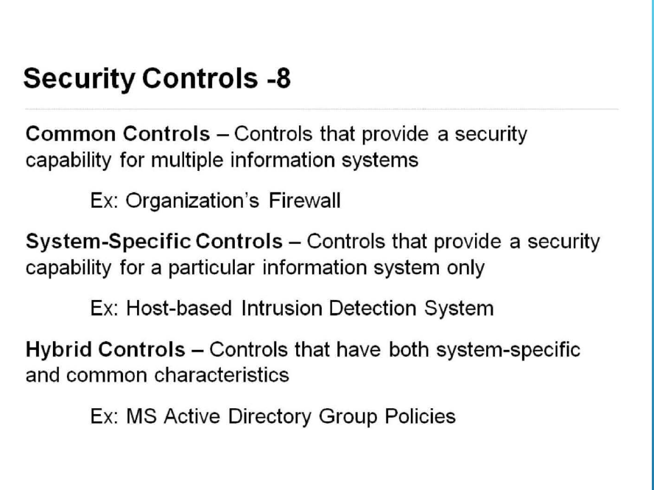
Implementation of Security Privacy Controls

Slide 52
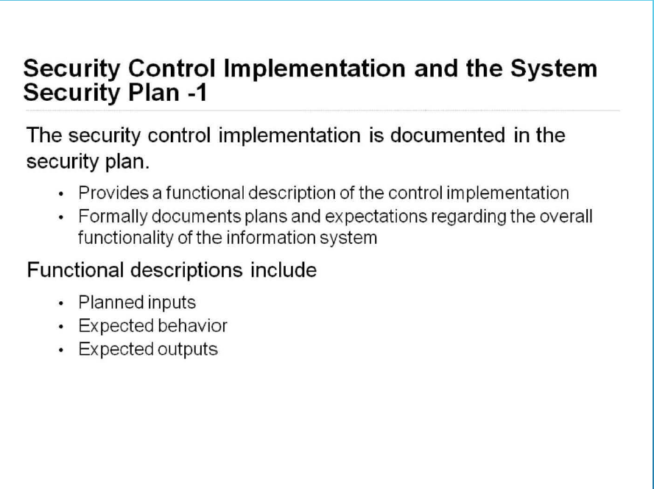
Implementation of Security Privacy Controls

Slide 53
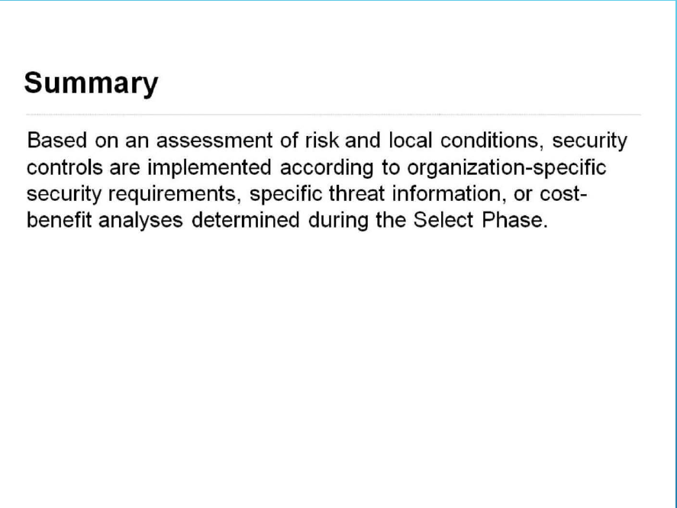
Implementation of Security Privacy Controls

Slide 54
Session 6: Assessment / Audit of Security Controls
Starting Point
SP 800-37 RV2
PREPARE
FIPS 199 / SP 800-60
CATEGORIZE Information System
FIPS 200 / SP 800-53
SELECT
Security Controls
SPs / 800-70
IMPLEMENT
Security Controls
SP 800-53A
ASSESS
Security Controls
SP 800-37
AUTHORIZE
Information System
SP 800-137
MONITOR
Security State

Slide 55
Assessment / Audit of Security Controls
Objective
Understand how to assess security controls to ensure they are effective and operating as stipulated
by the System Security Plan.
The purpose of the Assess step is to determine if the controls selected for implementation are
implemented correctly,
operating as intended, and
producing the desired outcome with respect to meeting the security and privacy requirements for the system and the organization.

Slide 56
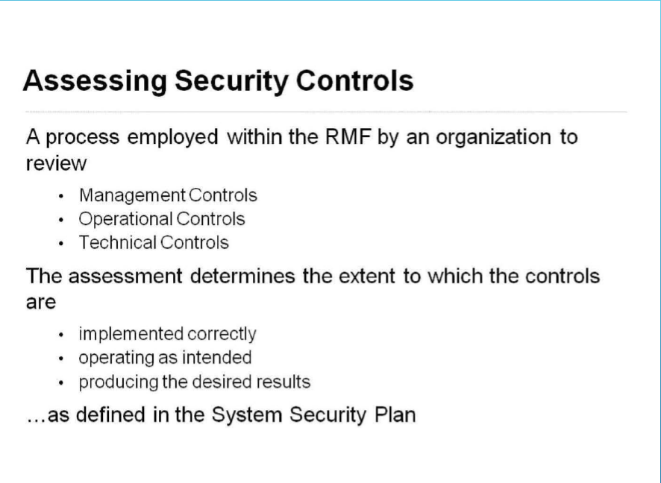
Assessment / Audit of Security Controls

Slide 57
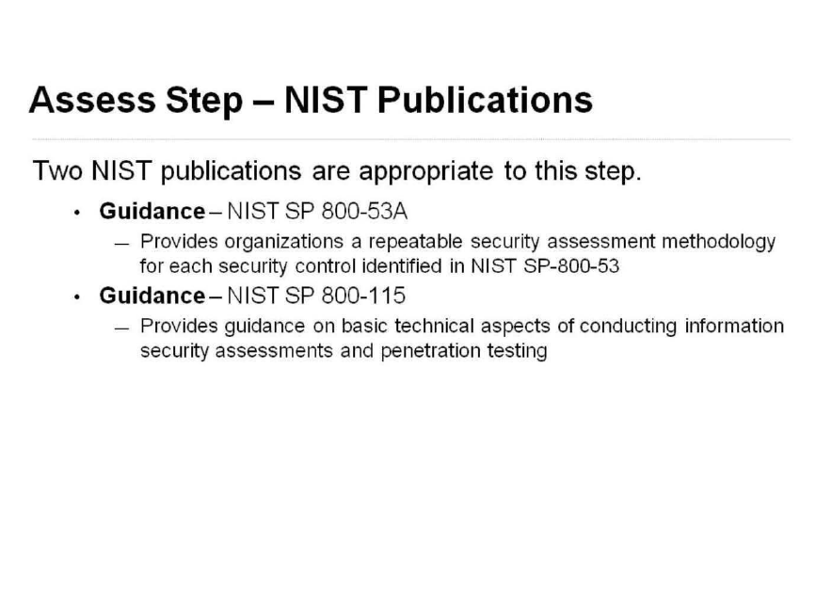
Assessment / Audit of Security Controls

Slide 58
Assessment / Audit of Security Controls
NIST SP 800-53A
Assessment Process
Preparing for Security Control Assessments
Developing Security Assessment Plans
Conduct Security Control Assessments
Analyzing Post Assessment Reports

Slide 59
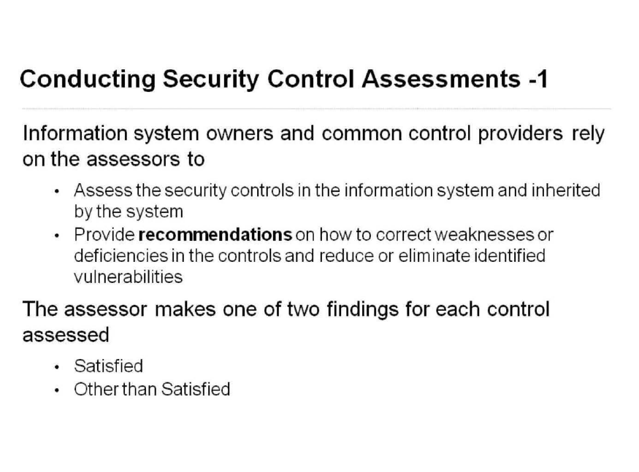
Assessment / Audit of Security Controls

Slide 60
Assessment / Audit of Security Controls
Types of assessments
Self-assessment by information system owners and common control providers
Independent assessments, audits or inspections

Slide 61
Assessment / Audit of Security Controls
Assessment Methods
Examine – This method is used to
Check the operation of IT mechanism,
insect physical security measures,
review security Policies and plans
Observe incident response activities
Interview – Involves conducting discussion within an organization to facilitate understanding, achieve clarification, or lead to the location of evidence.
Testing – Includes exercising one or more assessment objects under specified conditions to compare actual behavior with expected behavior e.g access control, Audit mechanism, security configuration settings.

Slide 62
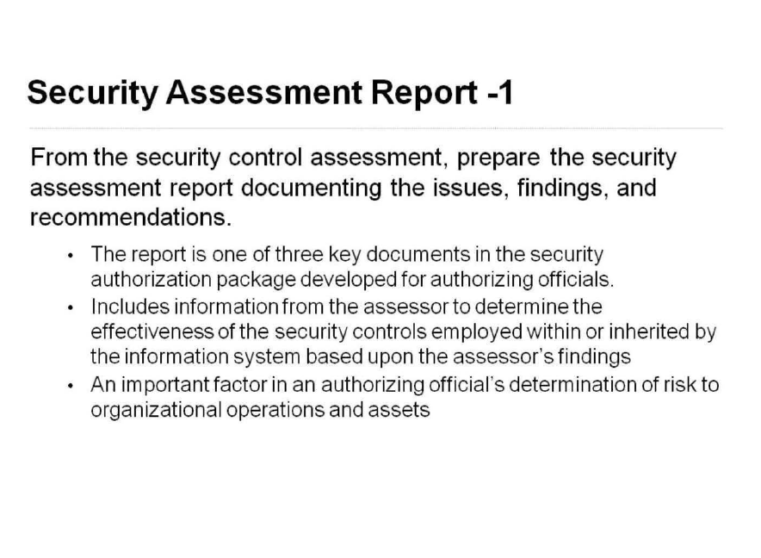
Assessment / Audit of Security Controls

Slide 63
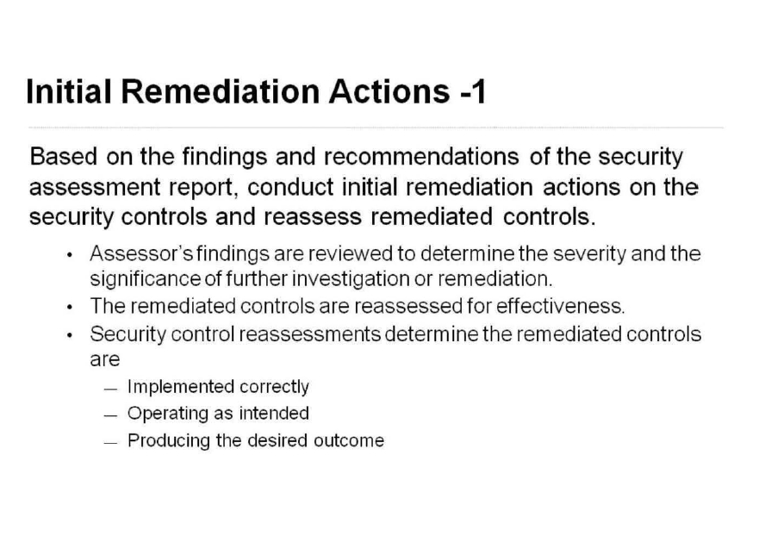
Assessment / Audit of Security Controls

Slide 64
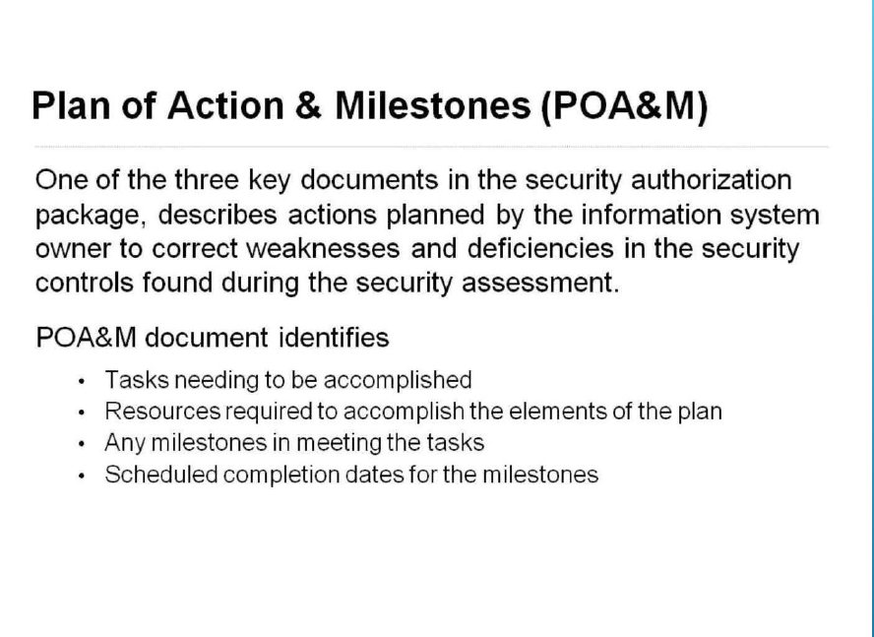
Assessment / Audit of Security Controls

Slide 65
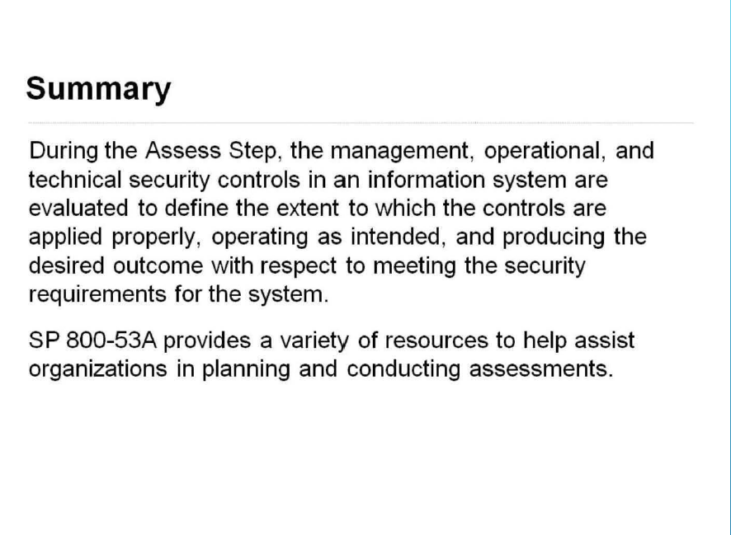
Assessment / Audit of Security Controls

Slide 66
Class Discussion
Why do we conduct assessment?
What RMF stage is the assessment?
Walk me through the RMF framework up to Assessment
What is a POA&M and why is it needed?
Difference between Satisfied and OTS

